Slide 1



EPIC 2.0 in 10 minutes
Prehospital Excellence in Management of Traumatic Brain Injury
EPIC Refresher v2.0 11/20/2020

Slide 2
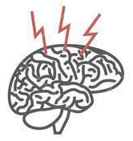

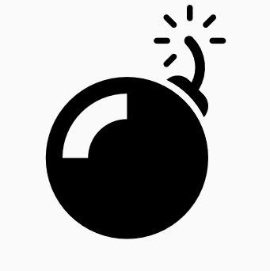


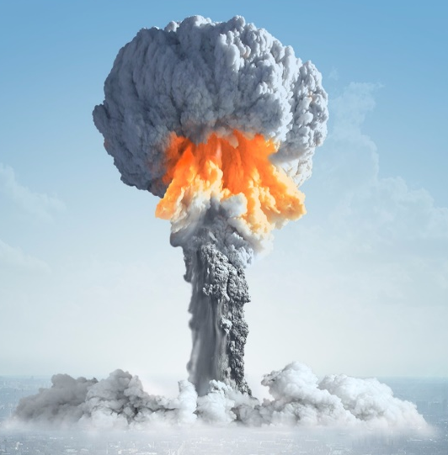
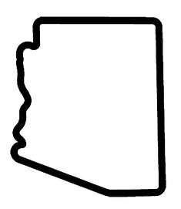

Key Findings: Statewide implementation of the Prehospital TBI Treatment Guidelines was independently associated with improvement in survival:
1. Among patients with severe TBI
2. Among intubated patients with severe TBI
What was EPIC 1.0? Impact of Implementing the EMS TBI Treatment Guidelines
POPULATION
21,852
Moderate, severe,
and critical
Traumatic Brain
Injury patients
Pre-implementation (P1): 15,228
Post-implementation (P3): 6,624
IMPLEMENTATION:
11,000 Arizona EMS Providers trained in TBI treatment guideline care
Conclusions: Adjusted odds of survival doubled among patients with severe TBI and tripled in the severe, intubated cohort. These findings support the widespread implementation of the prehospital TBI treatment guidelines.
Primary EMS Goal in Adult/Ped TBI:
Avoid/Treat the TBI
“H-Bombs”
TIMEFRAME
1/1/2007 to 6/30/2015
Severe TBI is defined as head injury severity score of 3-4
Hypoxia
Hypotension
Hyperventilation
O2 SAT ≥ 90 SBP ≥ 90
ETCO2 35-45
BUT: The effect faded over time
Frequent refreshing and QI
appear necessary to maintain excellent performance.
Don’t let the H-Bombs happen!!
NO
LOCATION
133
EMS agencies
across Arizona
EPIC 2.0 goal: Build on these findings.
Save and improve your TBI victims’ lives
Spaite, et al. Impact of Statewide Implementation of the Prehospital Traumatic Brain Injury Treatment Guidelines. May 8, 2019, JAMA Surg.
Notes:
Spend some time on this slide….there’s a lot of information that helps understand what we are trying to do with EPIC 2.0.
We lost a significant amount of the effect of EPIC on survival over the measurement period (36 months).
Please keep the possibility of TBI in your mind on all trauma patients, and provide EPIC care to all trauma patients if TBI is even a possibility
It you think TBI is possible, consider announcing it to your team: “I think this might be a TBI” or “Remember to give EPIC care to this patient” or something similar

Slide 3

Who is an EPIC patient?
Trauma, even a ground level fall
Sufficient injury to be transported to a hospital
Any loss of consciousness
  “He was out for a few seconds,” “I don’t remember”
  Repetitive questioning (“perseverating”):
    “What happened to me, again?”
Altered mental status
  BUT: GCS of 15 does not exclude major TBI
Seizure, unless it clearly preceded the trauma and the patient is now completely intact
Notes:
TBI outcomes worsen with age. An older person with a ground level fall and minor obvious head trauma (like a small head abrasion) is still a higher risk patient
Same with blood thinners (Eliquis, Coumadin, etc).
Repetitive questioning (or perseveration) is indicative of a TBI until proven otherwise.
Remember, seizure patients can sustain TBI with or independent of a seizure.
GCS measures changes in level of consciousness, but is not designed or able to predict or determine TBI.

Slide 4
Immediate Care: On Arrival
ABCDO2—Immediate high-flow O2
  First thing
    Wherever you find them (in car, behind shrubs, etc)
  Support ventilation as needed
  Never hyperventilate (ETCO2 40/10BPM (one vent/six sec.)
  Early IV insertion if altered mental status or any risk of multisystem trauma
  Pretreat to prevent hypoxia and hypotension
These simple interventions buy time for the injured brain
Notes:
Extrication, even when tools are not needed (getting a patient out of a back bedroom/bathroom, or out from behind the shrubs after an assault), often takes longer than expected. So does intubation. Get oxygen on immediately to increase oxygen levels early and prevent hypoxia during care.

Slide 5
Early Care in TBI/multisystem trauma
There’s no such thing as too much O2
  Good BLS care is critical
Monitor early and repeatedly watch:
  BP and Pulse ox
  ETCO2 (especially if BVM/advanced airway being used)
  Document frequently
Intubation or iGel/King use increases H-bomb risks
  Really think about whether a tube is indicated
Treat hypotension or impending hypotension (SBP<100)
Notes:
Always preoxygenate for the next crisis. Hypoxia worsens survival and outcomes in TBI.
Average EMS interval during EPIC was 26 minutes.
No one has ever shown that hyperoxygenation during EMS care causes problems.
Long transport times or risk of aspiration are reasons to consider ETI or SGA placement, but ETI or SGA make other risks (hypoxia during the attempt, hypotension if drugs are given, and especially hyperventilation) more likely.
Oxygen saturation is a lagging indicator…meaning that by the time you see it, the patient is already hypoxic and will remain hypoxic for some time (often a minute or more). When intubating, have someone watch the SPO2, and stop the attempt when SPO2 is 92 or greater.
Preoxygenation will often extend the time that intubation can be attempted by loading lots of oxygen into the bloodstream.

Slide 6

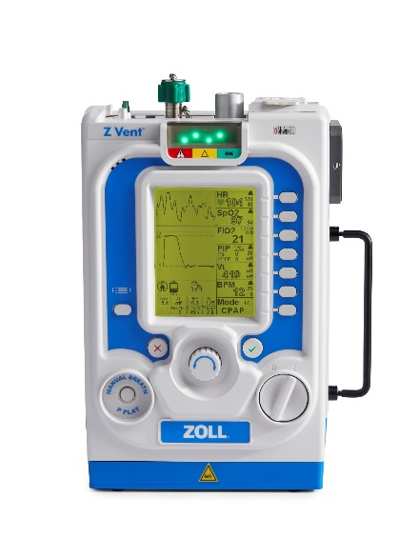
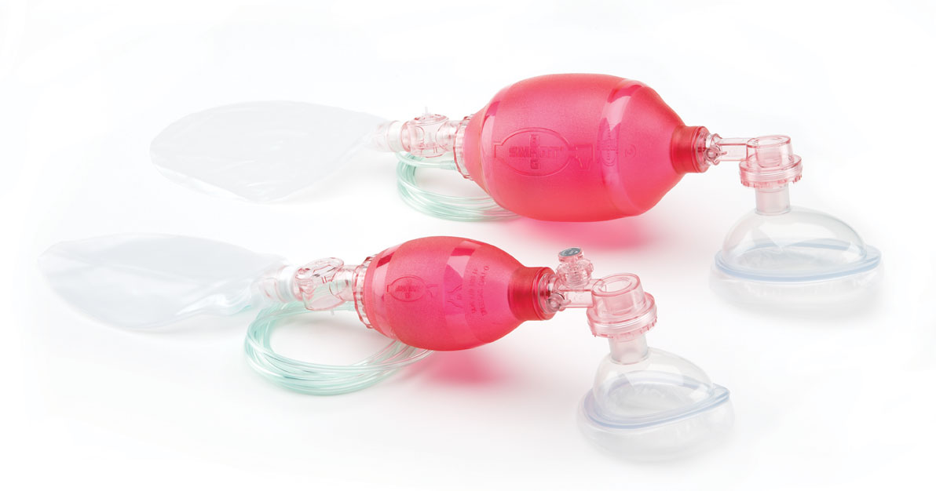
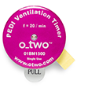
Use your resources
Ventilation EMT (V-EMT)
Ventilation rate timers
Flow control bags
Lower volume bags
ETCO2/SPO2/Ventilator
Spotter to monitor V-EMT
Place advanced airways only if absolutely necessary:
    If you don’t meticulously manage ventilation – your ALS airway is actually worse than a BLS airway
Notes:
Hyperventilation is incredibly easy to do, even when you are aware that it is a risk. Always monitor the ventilator EMT and ETCO2 to avoid ever hyperventilating a patient.
Advanced airways make it easy to hyperventilate. If sedatives or RSI is used in intubation, hypotension is also a significant risk

Slide 7
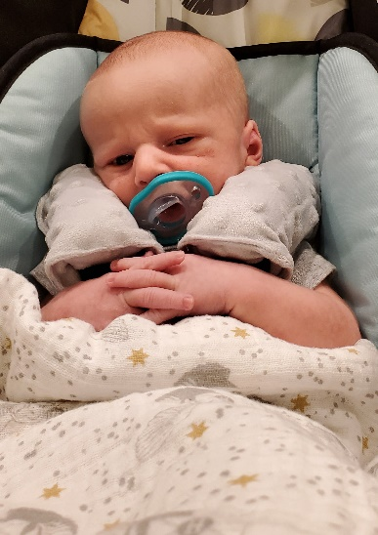
Peds Considerations
Similar approach
  Different VS and volume targets
  Close monitoring to catch early deterioration
Peds airway management:
  Basic maneuvers (BVM/O2, OPA/NPA)
  SGA or ETI only if basic efforts fail
  ETI often challenging & time consuming
  Consider other options if:
    High aspiration risk
    Long transport time
Notes:
These BP values (70 in infant, 80 in age 5, and 90 in age 10) are the basement….always keep the BP above these levels

Slide 8
Summary
This is simple…but simple is not necessarily easy
Give EPIC care to any potential TBI
  100% of the time
Stay focused--
  Practice EPIC just like CCR
Notes:
Run TBI scenarios. Practice ventilating while someone is monitoring your rate with a watch. This is an important skill
It’s easy to get distracted by the next shiny thing (covid! Ebola! Stop the Bleed!).
Remember the basics of good EPIC care on all trauma patients as you incorporate these new concepts, diseases and treatments.

Slide 9
Summary
Training resources and science are available at www.epic.arizona.edu
Download a QI Tool you can use on your TBI patients
Contact us with questions or comments
  https://epic.arizona.edu/contact

Slide 10


Special thanks to the
EPIC Partners
Arizona Fire Departments and EMS Agencies
WWW.EPIC.ARIZONA.EDU

