Slide 1



EPIC Run Review / Update
Sneaky TBI Patients
Case 663221
V1.0 3/2014

Slide 2
Sneaky TBI Patients
Actual TBI pts from Arizona agencies
Goal:
Quick Refresher/Run Review
TBI can be hard to spot in field
Review good TBI management
Outcomes-What happened?

Slide 3
Can EMS predict significant TBI?
No. Initial Trauma Center GCS can’t either.
73% of moderate to severe TBI patients have initial TC GCS scores of 13-15.
EMS GCS is no better at predicting TBI
Over HALF (52%) of moderate to severe TBI patients have normal GCS scores (4/5/6=15) initially.
GOAL: Treating EVERY trauma pt. using EPIC guidelines helps prevent secondary injury in all of them.
Source: ASTR and EPIC database, similar findings reported in Emerg Med J 2013;30:876 doi:10.1136/emermed-2013-203113.24

Slide 4
So Who is an EPIC Patient?
Trauma patients from any cause AND:
  GCS of 14 or less…OR…
  Multisystem trauma requiring intubation …OR…
  Post-traumatic seizures (whether continuing or not)
  Keep a high index of suspicion
Notes:
2nd bullet explanation: Multisystem trauma requiring intubation whether the need for intubation was from TBI or other potential injuries

Slide 5
How to Avoid the H-Bombs
  Hypoxia-
    Early High flow O2
    Keep SPO2 >90%
  Hypotension-
    Keep SBP >90
    Use caution with any sedation
  Hyperventilation-
    Monitor ETCO2
    Keep at 40 (35-45)
    Flow Controlled BVM
      Smartbag
    Ventilation Rate Timer
      One breath/6 sec.
    Ventilator (7cc/kg, 10bpm
    NEVER HYPERVENTILATE
  Your good care matters!!!!

Slide 6
Documentation
  Document
    VS q 5 min (including GCS, SPO2, ETCO2)
    Total Fluids given
    Fingerstick Blood Glucose (Treat if low)
    Care given, even if not consistent with EPIC guidelines. Do the best you can delivering quality care.

Slide 7
Actual Case
Case Criteria:
Prehospital GCS never below 13
Final Diagnosis of Moderate to Severe TBI
High cost (generally indicates higher injury severity).
Points to Remember:
TBI is very difficult to identify in the field.
All trauma are EPIC patients
Critically injured TBI patients often appear essentially normal early in care.

Slide 8
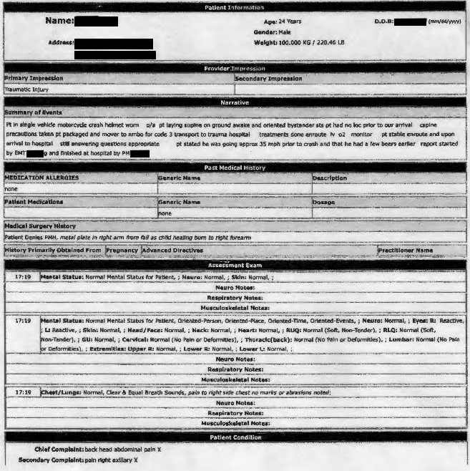
Actual Case

Slide 9
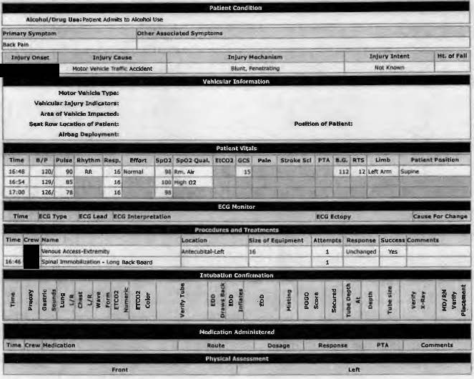
Actual Case

Slide 10
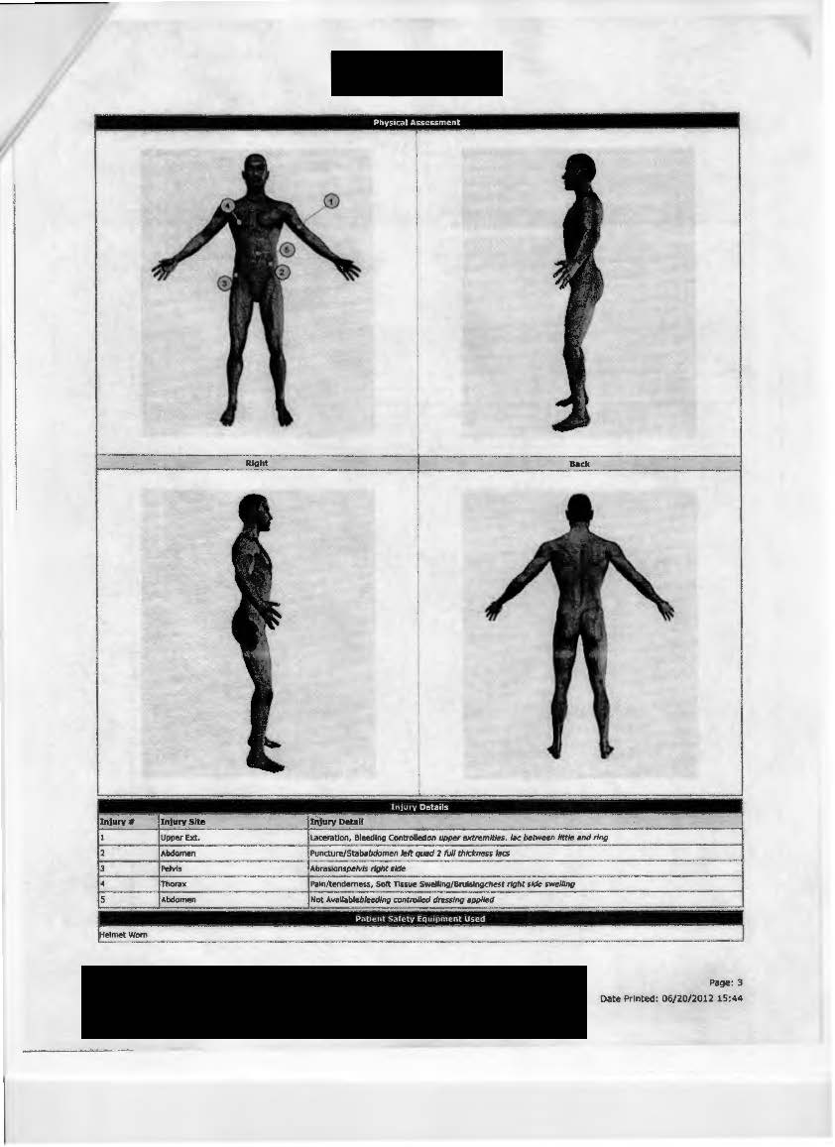
Actual Case

Slide 11
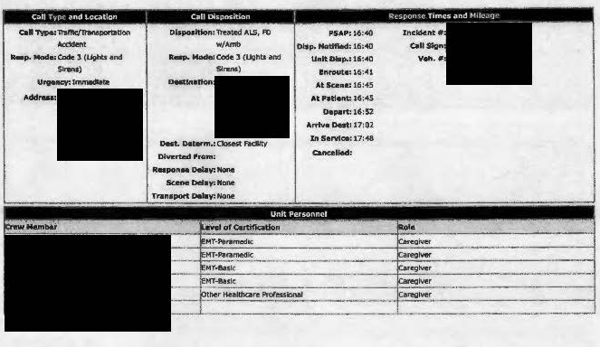
Actual Case

Slide 12
EPIC ID 663221
Motorcycle Accident
Major Injuries: Subdural hematoma, lung contusion, pneumo or hemothorax, subarachnoid hematoma, cerebral hemorrhage, liver and spleen lacerations, kidney contusion, GI tract injury.
Discharge Status
Rehab or Long Term Care
Comments: Great job!!! Very complex injuries not evident on scene, but assessed really well. Very severe injuries for a patient alert and oriented with no reported loss of consciousness. Great on scene time of 7 minutes. Case was before EPIC training.
These patients were chosen because they are hard to identify, but have significant injuries and high hospital expenses.
Clinical correlation (another set of eyes) is strongly recommended. If we have missed any care given, we apologize. We only look at data, not circumstances. We are not tracking individual performance. This is simply intended as a way to reinforce the best EPIC care possible using real cases you have been on and provide outcomes on cases.

Slide 13
Thanks from EPIC Team!
EPIC care matters.
Thanks for all you are doing!
Great work!

