Slide 1



EPIC 2.0:
Life-Saving EMS Management of TBI
v2.2AZ 6/8/2021

Slide 2
EPIC Provider Course
Content:
What Was the EPIC Study?
EPIC Findings
EPIC 2: The Sequel
H-Bomb Prevention/Treatment
Other Management

Slide 3



What is EPIC?
A unique EMS/Public Health partnership in Arizona, continuing to improve TBI care and outcomes

Slide 4
What Was The EPIC Study?
Excellence in Prehospital Injury Care Study
Statewide implementation of the Brain Trauma Foundation and the National Association of EMS Physicians Guidelines
Linked prehospital and hospital outcome data before and after TBI Guideline implementation
Demonstrated that EMS care can dramatically improve survival

Slide 5
Design:
Before/After System Evaluation
Phase I
Phase II
Phase III
Baseline
(mostly
retrospective)
Run-in
phase
Prospective:
post-intervention
Risk adjustment
and outcome
measurements
established before
intervention
Begin training
Training
complete
Analysis

Slide 6

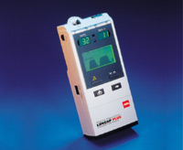
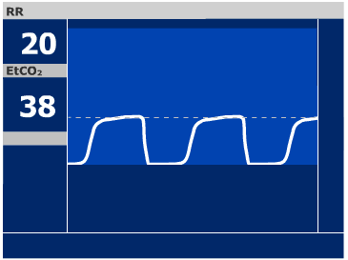

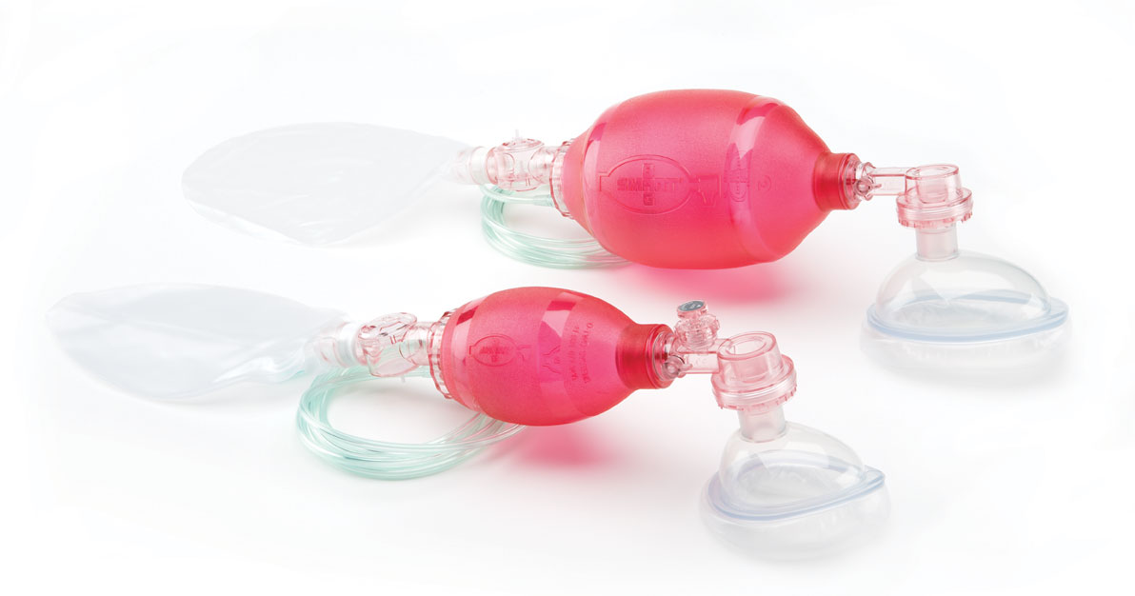
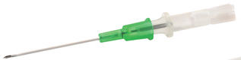
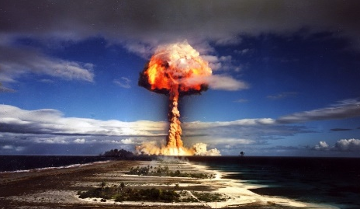
Purpose: Evaluate the impact of implementing the EMS TBI guidelines throughout Arizona
Implementing the EBGs
Aggressively prevent and treat the “Three H-Bombs of TBI”
    Hypoxemia
    Hypotension
    Hyperventilation
Scope of Implementation:
-EMS Agencies: >130 certified
~93% of TBIs statewide
-Master Trainers: >600 statewide
-EMS Providers: >11,000 trained (>80% of active providers)
-Major TBI Cases:
-Total: ~22,000; Intubated: 4,000

Slide 7

The Plan: Stop the 3 H-Bombs
Hypoxia
Aggressively prevent and treat:
  Threshold: ≥90% saturation
  Approach: All potential TBIs (LOC/transport)
    Immediately apply continuous, high flow O₂ via NRB
    No such thing as “hyper-oxygenation”
      Emphasis: “Pre-oxygenation” for everyone
        Prepare for “the unexpected crash”

Slide 8
The Plan: Stop the 3 H-Bombs
Any sign of inadequate oxygenation or ventilation →
  BVM
  Intubate/SGA only if inadequate oxygenation with BVM → Caveats:
    Vomiting/high risk for aspiration
    Long distance from hospital
Hypoxia

Slide 9

The Plan: Stop the 3 H-Bombs
(age 10+ years)
Aggressively prevent and treat:
  Threshold: SBP ≥90 mmHg
    IV crystalloids if:
      SBP approaching 90…or…
      Dropping rapidly
    Begin before they’re hypotensive
Hypotension
Initial 1000mL Bolus
Repeat 500mL Bolus
Repeat to keep SBP ≥90mmHg
Notes:
Kids: Initial bolus of 20cc/kg

Slide 10
The Plan: Stop the 3 H-Bombs
(age <10 years)
Aggressively prevent and treat:
  Threshold: SBP 70 mmHg + 2 x age
Hypotension
Initial 20 mL/kg Bolus
Repeat 10 mL/kg Bolus
Repeat to keep SBP above threshold
Notes:
Kids: Initial bolus of 20cc/kg

Slide 11
The Plan: Stop the 3 H-Bombs
Aggressively prevent and treat:
  Ventilation rates
    Adults (15+): 10 BPM
    Kids 2-14: 20 BPM
    Infants: 25 BPM
Hyperventilation
Notes:
Kids: Initial bolus of 20cc/kg

Slide 12
The Plan: Stop the 3 H-Bombs
Adjuncts are absolutely necessary
  Two-finger bag technique
    One-finger in kids age <15
  Flow-controlled bag
  Ventilation Rate Timer
Hyperventilation
Notes:
Kids: Initial bolus of 20cc/kg

Slide 13
The Plan: Stop the 3 H-Bombs
ETCO₂ monitoring:
  Target: 40 mmHg
  Range: 35-45
  V-EMT
    Most important team member
  “Spotter”!!!
Hyperventilation
Notes:
V-EMT is supposed to be MANIACAL. And…don’t forget…”Where’s my ventilator!!!???”

Slide 14
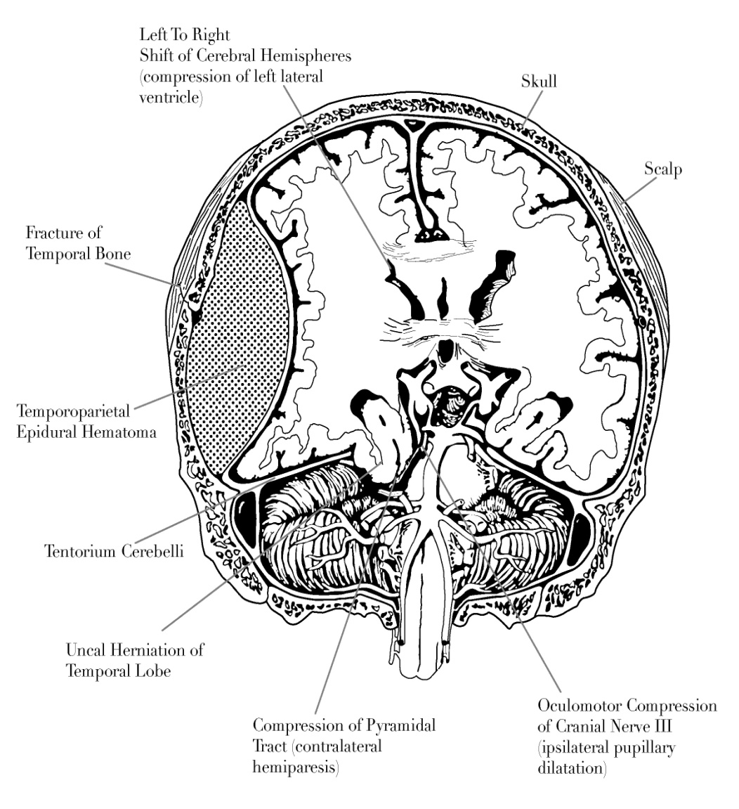
Scope of EPIC
21,852 patients
  Pre-implementation: 15,228
  Post-implementation: 6624
4,014 intubated patients
2007-2015: Data collection
2015-2019: Data analysis, cleaning and prepublication work
2019: Publication
2021: EPIC4Kids publication
Notes:
Largest project of its kind ever

Slide 17
Results: EPIC Implementation was associated with:
A lower rate of intubation…despite greater injury severity
A much higher rate of BVM-only airway management
A greater likelihood of having an SpO₂ of 100%
A greater reversal of hypoxia by the time of TC arrival
A greater likelihood of receiving a fluid bolus in hypotensive and near-hypotensive patients
A greater volume of fluid boluses in hypotensive and near-hypotensive patients
A lower rate of hyperventilation/hypocapnia in intubated patients

Slide 18
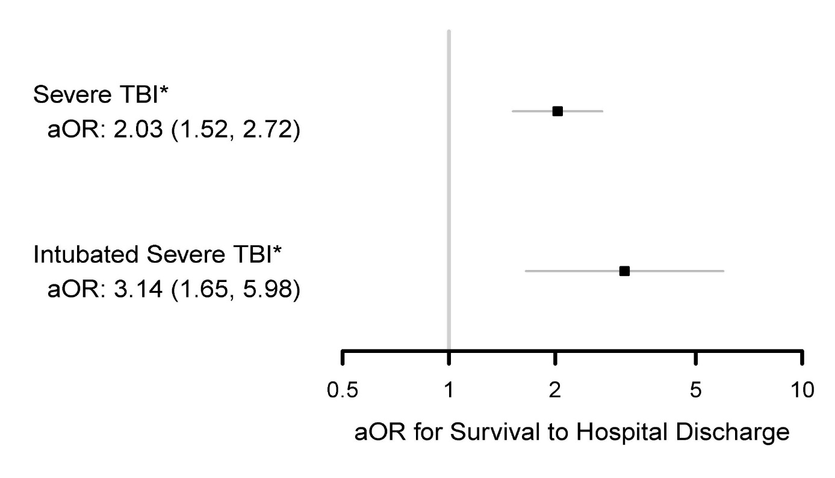
Survival to Hospital Discharge in Severe TBI
Severe TBI: DOUBLING of adjusted odds of survival
Intubated, Severe TBI: TRIPLING of adjusted odds of survival
29 minutes of EMS care (average) affected Survival to Hospital Discharge!
Notes:
Average EMS interval during EPIC was 26 minutes. This first 26 minutes affected hospital discharge outcomes days or weeks later

Slide 19
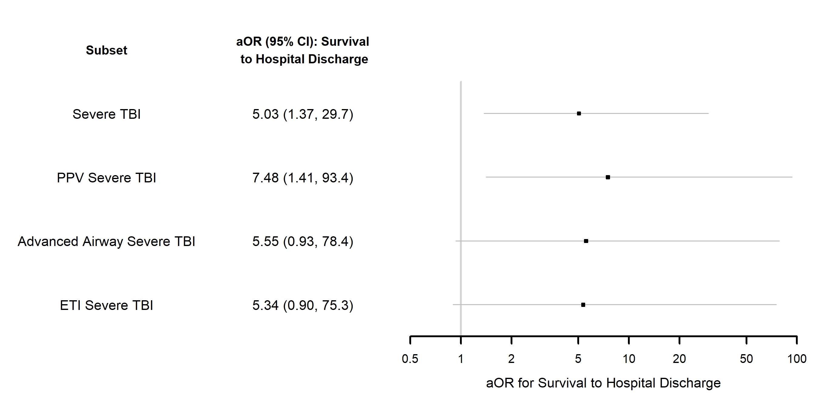
Pediatric Survival Outcomes in Severe TBI
Severe TBI: FIVE-FOLD increase in adjusted odds of survival
Intubated, Severe: FIVE-FOLD increase in adjusted odds of survival
Positive Pressure Ventilated:
  Over SEVEN-FOLD increase in adjusted odds of survival

Slide 20
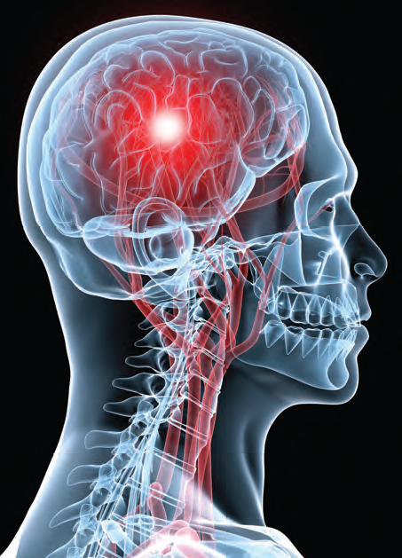
Takeaway #1: If EPIC’s findings hold true…this is a quantum leap in outcomes
Changes in mortality almost always occur incrementally in medicine
A rare event:
  Dramatic survival improvement…. in a major public health problem
Notes:
Most successful advances in treatment lead to significant…but relatively small…increments in outcome
“The Big One”…preventing death

Slide 21
Takeaway #2: Effective interventions are rarely simple or inexpensive
The beauty of the "Three H-Bombs”:
  Managed by simple interventions
  No expensive, magic drug (no Un-obtainium®)
  EMS providers already know how to:
    Deliver high flow oxygen, initiate IVs, intubate/ventilate
It’s just three simple interventions…done right!!!
Notes:
Not a million-dollar un-obtanium (patented Dr. Spaite term)

Slide 22
Takeaway #3: EPIC Care can be done almost anywhere
The interventions:
  Are “Simple”
  Don’t require additional expensive equipment
  Don’t require extensive training
The guidelines are implementable in nearly every EMS system in the country…and even most of the world
Notes:
But note that SIMPLE does not mean EASY

Slide 23
Takeaway #4: Don’t confuse “Simple” with “Easy”
This is really hard to do well…consistently
EPIC effect degraded over time
  The provider…and the system…must keep their eye on the ball or old habits inevitably return
Notes:
Falloff in outcomes likely between the early evaluation period after training and the later evaluation period after training

Slide 24


What Is EPIC 2.0?
A program to:
  Review EPIC Study findings
  Incorporate into EMS systems
  Train EMS in evidence-based practice
Goal: Improve TBI care and outcomes in United States and around the world

Slide 25


Why does this matter to me?
Notes:
Can use either graphic

Slide 26

The Stakes are HIGH!!!
A mild to moderate primary brain injury can become a severe TBI from secondary injury due to failure to properly prevent and treat the H-Bombs
Notes:
Systemic hypoxia-E.g., hypoventilation
Hypotension, causing hypoperfusion
Hyperventilation, causing cerebral vasoconstriction

Slide 27
Primary Brain Injury
Injury that occurs at the moment of impact
  Currently, no EMS or hospital treatments can alter the primary injury
Damage is already done

Slide 28
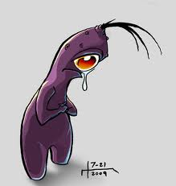
Secondary Brain Injury
Occurs after the initial injury
Caused By:
  Hypoxia
  Poor CNS blood flow
    Hypotension
    Hyperventilation
Major impact on outcome
Do EVERYTHING you can to PREVENT secondary brain injury
Notes:
--There is now overwhelming evidence that decreased blood flow to the brain is a major cause of CELLULAR hypoxia…even if there is no SYSTEMIC hypoxia because low flow causes ischemia at the neuronal level due do inadequate oxygen DELIVERY. In other words…TWO things need to happen to keep neurons alive: 1) the blood has be adequately oxygenated…and 2) the oxygenated RBCs have to make it out into the tissue capillaries in adequate volumes to carry enough 02 to the cells.
Systemic hypoxia-E.g., hypoventilation
Hypotension, causing hypoperfusion
Hyperventilation, causing cerebral vasoconstriction

Slide 29
So What Does This Mean to EMS?
A live brain is worth a roomful of neurosurgeons
In fact…there’s synergism between EMS and hospital care:
  Excellent prehospital care that prevents 2ndary brain injury…allows TBI patients to benefit from trauma/critical care
  But…if you lose the neurons in the field…even perfect surgical/critical care can’t bring them back
Notes:
26 minutes of EMS care (average time) had effects on survival days later
YOUR care may determine TBI outcome
YOUR care may be more important than Trauma/Neuro Surgeon care
Why? They can’t fix what’s lost in the field

Slide 30
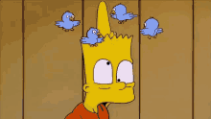
Implementing the Guidelines:
Who’s an EPIC Patient?
Trauma, even a ground level fall with:
Sufficient injury to be transported to a hospital…and…
Any loss of consciousness
  “He was out for a few seconds”
  “I saw stars” or “I don’t remember”
Repetitive questioning (“perseverating”):
  “What happened to me, again?”
Altered mental status
  But …GCS of 15 does NOT exclude major TBI
Notes:
TBI outcomes worsen with age. An older person with a ground level fall and minor obvious head trauma (like a small head abrasion) is still a higher risk patient
Same with blood thinners (Eliquis, Coumadin, etc).
Repetitive questioning (or perseveration) is indicative of a TBI until proven otherwise.
Remember, seizure patients can sustain TBI with or independent of a seizure.
GCS measures changes in level of consciousness, but is not designed or able to predict or determine TBI.
Multisystem trauma requiring intubation WHETHER THE NEED FOR INTUBATION IS FROM THE HEAD INJURY OR NOT

Slide 31
Implementing the Guidelines:
Who’s an EPIC Patient?
Trauma, even a ground level fall with:
Sufficient injury to be transported to a hospital…and…
Any loss of consciousness
Altered mental status
  BUT: GCS of 15 does NOT exclude major TBI
Notes:
TBI outcomes worsen with age. An older person with a ground level fall and minor obvious head trauma (like a small head abrasion) is still a higher risk patient
Same with blood thinners (Eliquis, Coumadin, etc).
Repetitive questioning (or perseveration) is indicative of a TBI until proven otherwise.
Remember, seizure patients can sustain TBI with or independent of a seizure.
GCS measures changes in level of consciousness, but is not designed or able to predict or determine TBI.
Multisystem trauma requiring intubation WHETHER THE NEED FOR INTUBATION IS FROM THE HEAD INJURY OR NOT

Slide 32
Who’s an EPIC Patient? (Cont’d)
Seizure with trauma
  Can occur before trauma (seizure leading to TBI) or
  After the trauma (post-traumatic seizures)
Multisystem trauma requiring PPV
  Basic or advanced
Risk Factors:
  Older age (even over 40!)
  Anticoagulants (Coumadin, Eliquis, etc.)
Notes:
TBI outcomes worsen with age. An older person with a ground level fall and minor obvious head trauma (like a small head abrasion) is still a higher risk patient
Same with blood thinners (Eliquis, Coumadin, etc).
Repetitive questioning (or perseveration) is indicative of a TBI until proven otherwise.
Remember, seizure patients can sustain TBI with or independent of a seizure.
GCS measures changes in level of consciousness, but is not designed or able to predict or determine TBI.
Multisystem trauma requiring intubation WHETHER THE NEED FOR INTUBATION IS FROM THE HEAD INJURY OR NOT

Slide 33
What if I don’t know if they had a LOC?
Head injury patients are poor historians!
Consider the whole scene:
  Trauma
  Physical exam
  Mechanism
  Reports from others of LOC (Police – bystanders)
  Perseverating (what happened?, what happened?)
  Risk factors
Notes:
TBI outcomes worsen with age. An older person with a ground level fall and minor obvious head trauma (like a small head abrasion) is still a higher risk patient
Same with blood thinners (Eliquis, Coumadin, etc).
Repetitive questioning (or perseveration) is indicative of a TBI until proven otherwise.
Remember, seizure patients can sustain TBI with or independent of a seizure.
GCS measures changes in level of consciousness, but is not designed or able to predict or determine TBI.
Multisystem trauma requiring intubation WHETHER THE NEED FOR INTUBATION IS FROM THE HEAD INJURY OR NOT

Slide 34
When in Doubt
Treat with EPIC protocol
Notes:
Very little harm with EPIC care in patients who are not clearly EPIC level injuries

Slide 35

Key Concept: A live body…with a dead brain… is really a dead body
How Do I Deliver A Live Brain?
Stop the “H-Bombs” by preventing and treating them:
Hypoxia
Hypotension
Hyperventilation
Notes:
Moved here in V7

Slide 36
Oxygen Administration is Critical
Even one episode of hypoxia doubles mortality
Good BLS airway management is critical
Patients can deteriorate rapidly
  Prepare for the unexpected “crash”
Aim for O₂ sat of 100%
  There’s no such thing as too much O₂ in TBI
Short term hyper-oxia risk is dwarfed by the risk of failing to pre-oxygenate and prevent hypoxia
Hypoxia
Notes:
Preoxygenation extends time to intubate before becoming hypoxic
Always preoxygenate for the next crisis. Hypoxia worsens survival and outcomes in TBI.
Average EMS interval during EPIC was 26 minutes.
No one has ever shown that hyperoxygenation during EMS care causes problems.

Slide 37
Aggressively PREVENT and Treat
Hypoxia
Standard: Keep SpO₂≥90%
  Continuous high-flow NRB O₂
    First thing on anyone who has lost consciousness
    Even with normal mental status & good pulse ox
  Apply O₂ before extrication!
    Apply in the car or wherever found
  Early and ongoing high flow NRB O₂ can prevent hypoxia in patients who deteriorate and require airway/ventilation support
Notes:
Preoxygenation extends time to intubate before becoming hypoxic
Oxygen saturation is a lagging indicator…meaning that by the time you see it, the patient is already hypoxic and will remain hypoxic for some time (often a minute or more). When intubating, have someone watch the SPO2, and stop the attempt when SPO2 is 92 or greater.
Note: in anesthetized swine, they can go as long as 8 minutes before becoming hypoxic after complete pre-oxygenation compared to less than 2 minutes without pre-oxygenation. (“pre-oxygenation will save your bacon!!!”)

Slide 38

Oxygen Application is Missed a LOT!!!
Pt states he did not lose consciousness, keeps asking, “What happened?”
https://youtu.be/ZlvRwdd5msc
Notes:
Important to emphasize that the patient had LOC...has had a LOT of time spent with EMS...without HFO2...and the fact that he's awake doesn't preclude his need for HFO2. Particularly important since the patient has clearly had >20...maybe >30 minutes of EMS care...WITHOUT O2 onboard. And...he's being taken to altitude...which will lower his blood oxygenation...and...he isn't being pre-oxygenated...which he absolutely needs...in case he deteriorates/crashes while being flown to the hospital.

Slide 39
Aggressive BLS…Cautious ALS
Hypoxia
If any sign of inadequate oxygenation or ventilation →
  Use BVM
  OPA or NPA if possible
  Do not hyper/over-ventilate
Advanced airway (ETI/SGA) only if inadequate oxygenation with BVM →
  Considerations:
    Vomiting/high risk for aspiration
    Long transport time
Notes:
Always preoxygenate for the next crisis. Hypoxia worsens survival and outcomes in TBI.
No one has ever shown that hyperoxygenation during EMS care causes problems.
Long transport times or risk of aspiration are reasons to consider ETI or SGA placement, but ETI or SGA make other risks (hypoxia during the attempt, hypotension if drugs are given, and especially hyperventilation) more likely.
Oxygen saturation is a lagging indicator…meaning that by the time you see it, the patient is already hypoxic and will remain hypoxic for some time (often a minute or more). When intubating, have someone watch the SPO2, and stop the attempt when SPO2 is 92 or greater.
Preoxygenation will often extend the time that intubation can be attempted by loading lots of oxygen into the bloodstream.

Slide 40
Use Tools For Success
Hypoxia
Flow controlled or reduced volume BVM
Ventilation rate timer (timing light)
Target ETCO2: 40 mmHg (range 35-45)
V-EMT
Ventilation Spotter (if sufficient personnel)
Monitor-based ventilation/TBI dashboard
Early ventilator use
  Start at 5-6 cc/kg @ 10/min
  Follow your agency’s vent protocols
Emerging technologies
Notes:
Preoxygenation extends time to intubate before becoming hypoxic
V-EMT is the ventilatory EMT. The person doing the bagging. Nothing should be more important than keeping ventilations managed and within guidelines
Ventilator settings based on Ideal Body Weight
Monitors are available with TBI dashboards and ventilation modules that may make monitoring easier (if you pay attention, that is)

Slide 41
Prevent Hypoxia During Intubation
Hypoxia
DON’T: Ever let this happen during intubation:
Severe, profound hypoxia….two minutes of severe secondary injury
Pre-oxygenation can never be emphasized too much

Slide 42
If You Choose to Intubate….
Hypoxia
You aren’t finished when intubation is complete!
You must meticulously monitor/manage ventilation (rate/depth/ETCO₂)/SPO₂)
If you don’t…your ALS airway is actually worse than a BLS airway
Notes:
Our work is not done after the intubation!

Slide 43
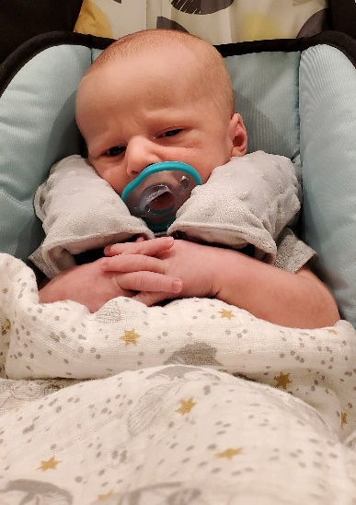
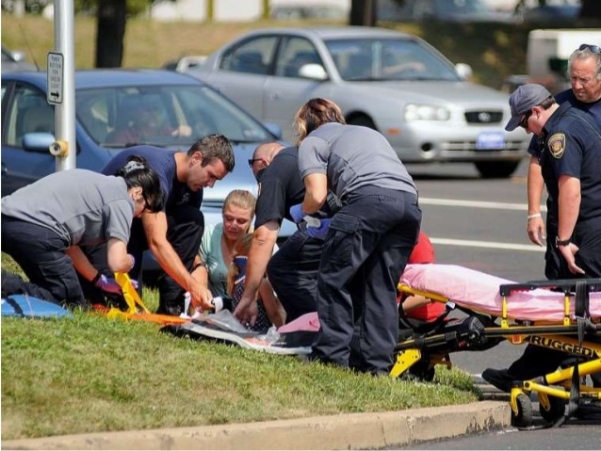
EPIC4Kids
Hypoxia
Basic airway maneuvers usually fine
  BVM/O₂, OPA/NPA if needed
  BLS airway probably safer in most instances
SGA or ETI only if basic efforts fail
  Consider advanced options if:
    High aspiration risk
    Long transport time
Pediatric intubation is often challenging & time consuming
Notes:
Note: Positive pressure ventilation decreases venous return to the heart and decreases cardiac output. Thus, ETI/PPV can induce hypotension in patients with compensated or early shock.

Slide 44
Aggressively PREVENT and Treat (age 10+)
Hypotension
Standard: Keep SBP ≥90mmHg
  IV crystalloids if:
      SBP approaching 90…or…
      Dropping rapidly
  Begin before hypotension
Initial1000mL Bolus
Repeat 500mL Bolus
Repeat to keep SBP ≥90mmHg
Notes:
Kids: Initial bolus of 20cc/kg

Slide 45
Hypotension in Kids (age<10)
Hypotension
Close monitoring to catch early deterioration
Always keep pediatric SBP above:
    Infant: 70 mmHg
    5 year old: 80 mmHg
    10 and older: 90 mmHg (Same as adults)
Hypotension < [70 + 2X age]
Notes:
These BP values (70 in infant, 80 in age 5, and 90 in age 10) are the basement….always keep the BP above these levels

Slide 46



Hypotension In Kids
Hypotension
=70
Initial 20mL/Kg NS Bolus for hypotension or other signs of shock
Repeat bolus every 5 min if needed to keep B/P above threshold
Frequently repeat VS
5
=80
10
=90
Notes:
Other signs of shock: cool/clammy, pale, poor capillary refill, tachy and decreasing SBP even if not yet “officially” hypotensive (e.g., 5 y/o drops from 120 to 90 and HR now 140).
Age appropriate B/P
Infant: 70 mmHg
5 year old: 80 mmHg
10 and older: 90 mmHg

Slide 47
Caution: Sedation and Pain Control
Hypotension
Can RAPIDLY drop BP and reduce blood flow to brain
  Morphine
  Fentanyl
  Midazolam (Versed)
  Diazepam (Valium)
  Lorazepam (Ativan)
Notes:
By causing veno-dilation, these drugs reduce venous return to the heart and, thus, decrease cardiac output and can compromise cerebral blood flow. Since the brain stores no oxygen, and stores no glucose, it must be perfused to remain oxygenated and fueled. Hypotension decreases blood flow.
When you give these medications to someone that is in compensated shock, you take the bodies ability away to compensate.

Slide 48
Caution: Sedation/RSI
Hypotension
Use sedatives with caution:
    Vasodilation in compensated shock can plummet BP
    Start with VERY low dose: ≈1/4 usual dose (example: 1mg midazolam vs. 5mg)
    Carefully monitor BP
    Don’t give if BP low or falling!!!
    Judicious use even after intubation:
      Reversing agents don’t reverse vascular effects
Notes:
By causing veno-dilation, these drugs reduce venous return to the heart and, thus, decrease cardiac output and can compromise cerebral blood flow. Since the brain stores no oxygen, and stores no glucose, it must be perfused to remain oxygenated and fueled. Hypotension decreases blood flow.
When you give these medications to someone that is in compensated shock, you take the bodies ability away to compensate.

Slide 49
Prevention of Hyper/over-ventilation!!!
Hypocapnia dramatically reduces cerebral blood flow
Everyone hyperventilates without meticulous prevention
Most important person in TBI:
  The V-EMT—The Ventilatory-EMT bagging the patient
If we aren’t paying constant attention to ventilation…we will harm the patient
Hyperventilation

Slide 50
Managing Ventilation: Adults and Kids
Initial Ventilation Rates:
  Infants: (age 0-24 months): 25 bpm
  Children: (age 2-14): 20 bpm
  Adolescents/adults: (age 15+): 10 bpm
ETCO2:
  “Titrate” (gently adjust volume/rate) to 40 mmHg
    Range 35-45 mmHg
Hyperventilation

Slide 51
Ventilation is so hard to do right!!!
If you properly ventilate…it will feel like you’re hypo-ventilating!!! →
  Get used to it!!!
  The unaided human hand…and distracted mind…always bag too rapidly…too deeply…and with too much pressure
Hyperventilation

Slide 52
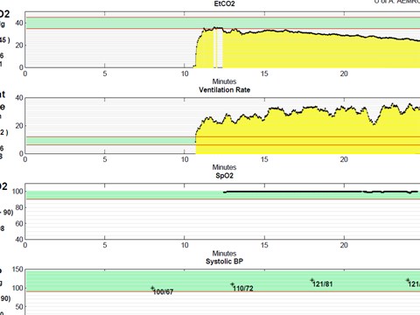
Inadvertent Ventilatory Inattentiveness
Falling ETCO2
Increasing
Ventilation Rate
Notes:
Why are we so maniacal about preventing hyperventilation??? NO ONE can manually ventilate properly without ventilation adjuncts!!!
100% of emergency care providers have a very specific neuropsychiatric disorder…Inadvertent Ventilatory Inattentiveness or IVI

Slide 53
What About Cerebral “Herniation”?
RARE in the prehospital environment
Ominous prognosis…no matter what EMS or hospitals do
Notes:
Severe TBI patients may have unequal pupils, less (or no) movement on one side of the body, breathing abnormalities, and other CNS signs, but are not and never will herniate. Don’t sacrifice the severe TBI patients (who can benefit from EPIC care) by hyperventilating them and causing secondary injury!

Slide 54
What About “Herniation”?
Non-herniating patients can mimic herniation…the exam is very challenging and often not corroborated by subsequent CT:
  Coma/posturing
  Unequal/dilated pupils
  Decreased movement on one side
  Breathing abnormalities
Thus…prehospital “therapeutic” hyperventilation has essentially no chance of improving outcome in true herniation…but harms survivable patients who present with herniation-like signs
Notes:
Severe TBI patients may have unequal pupils, less (or no) movement on one side of the body, breathing abnormalities, and other CNS signs, but are not and never will herniate. Don’t sacrifice the severe TBI patients (who can benefit from EPIC care) by hyperventilating them and causing secondary injury!

Slide 55
FIVE Things To Remember
1. High flow O2 on all injured patients with LOC and being transported
  O2 Sat > 90% at all times
2. Keep SBP ≥90…treat them before they’re hypotensive
3. Be cautious with sedatives/narcs if any possibility of bleeding
4. Advanced airway only when basic airway fails to adequately oxygenate, long transport, or high aspiration risk
5. Be maniacal about preventing hyperventilation…CO2 at 40
Notes:
Removed duplicate bullet in version 7.0
O2 on first thing, as soon as crew gets on scene, before even assessing full extent of injuries. EARLY!!!

Slide 56
FIVE Things To Document
Q5 minutes
  1. B/P, Pulse, Resp Rate, O2 Sat
  2. ETCO2
  3. GCS
Once:
  4. Initial Blood Glucose
  5. Total fluids given

Slide 57
Take Home Messages
In the EPIC Study…implementation of the EMS TBI Guidelines was independently associated with a doubling of the adjusted odds of survival in severe TBI and a tripling in severe, intubated TBI
The aggressive prevention and treatment of the 3 H-Bombs appear to be the first effective approach to TBI identified in nearly half a century

Slide 58
Summary
Can’t give too much O₂ in the field
Great BLS care is critical
Vigilant monitoring
  Constant pulse ox, BP Q5
  Constant ETCO2 with advanced airway
Intubation/SGA increases H-bomb risks
  Carefully consider if tube is indicated
Treat impending hypotension in TBI
  SBP<100, <110 if dropping
Notes:
Run TBI scenarios. Practice ventilating while someone is monitoring your rate with a watch. This is an important skill
It’s easy to get distracted by the next shiny thing (covid! Ebola! Stop the Bleed!).
Remember the basics of good EPIC care on all trauma patients as you incorporate these new concepts, diseases and treatments.

Slide 59
Resources
Resources available at www.epic.arizona.edu
Training resources, Blue Book
Publications and science
Algorithms
Download a QI Tool you can use on your TBI patients
Contact us with questions or comments:
  https://epic.arizona.edu/contact

Slide 60
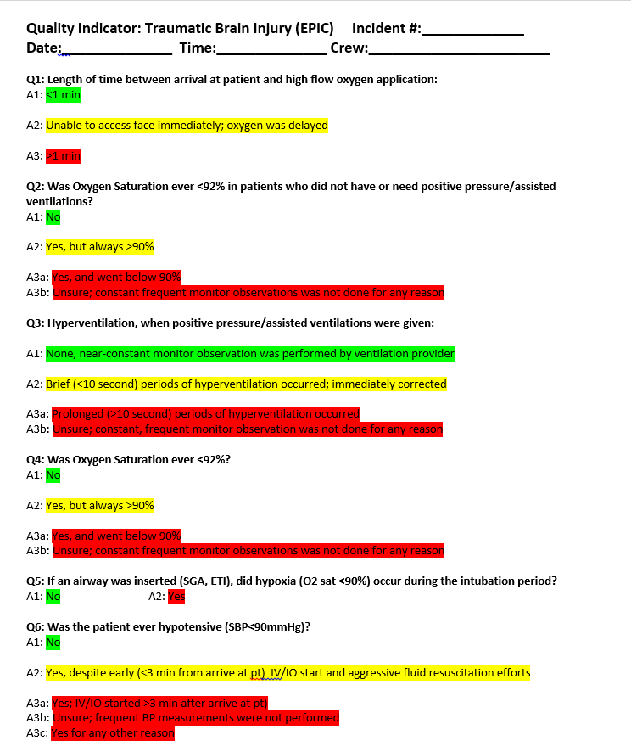
TBI QI Tool:
For use either agency wide or on an individual crew basis
Goal is excellent care and best outcomes possible
Available at www.epic.arizona.edu

Slide 61

Special Thanks To:
Arizona Fire Depts and EMS Agencies
Arizona Department of Health Services
Bureau of Emergency Medical Services and Trauma System
WWW.EPIC.ARIZONA.EDU

